Slide 1
Natural Language Processing Tutorial 3: Word Vector Representation
Winter 2021-2022
Tomer Volk Based on slides by Omer Ben-Porat, Nadav Oved and Eyal Ben-David

Slide 2
Agenda
Word Similarity
Word2Vec
GloVe
Discussion

Slide 3
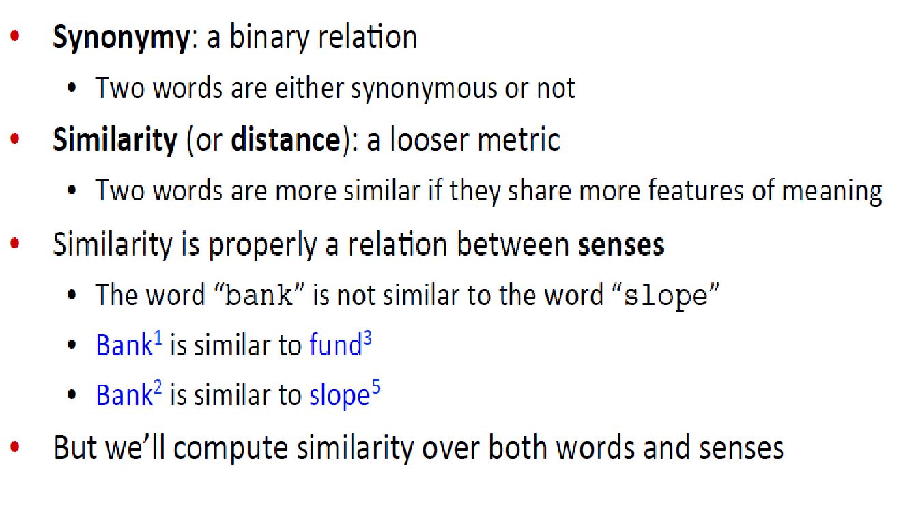
Word Similarity

Slide 4
Word Embeddings
Fixed size vectors
Used to capture word meaning
Used to determine word similarity
Manageable dimension vector space
Allow us to easily input textual data into Neural Networks

Slide 5
Word Embedding - Goal
Derive vector representations for words (and phrases) which capture:
Word meaning
Word sense
Word similarity
Word distribution
By their context words!
A dense vector representation could assist with sparsity in language, especially when dealing with large corpuses
This is done by training a shallow Neural Network on a “utility” task

Slide 6
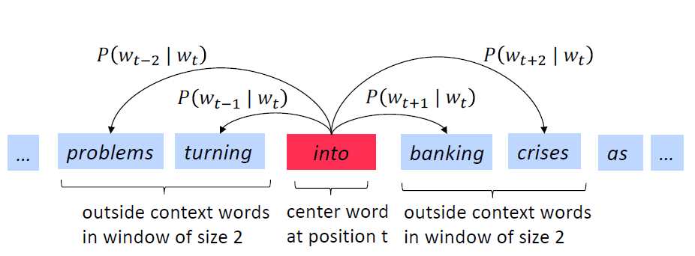
Word2Vec - Objective
Define a context-window size and iterate over entire corpus:
Stanford NLP with Deep Learning Course 2019
Chris Manning and Abigail See

Slide 7
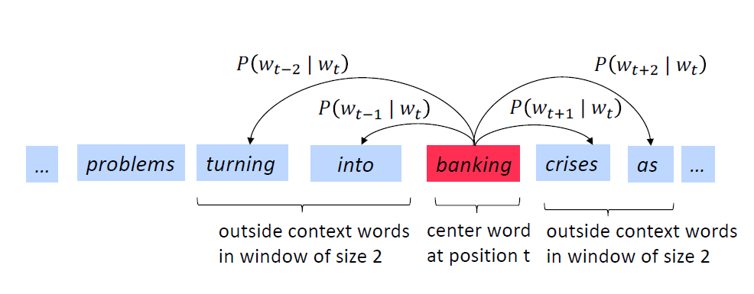
Word2Vec - Objective
Stanford NLP with Deep Learning Course 2019
Chris Manning and Abigail See

Slide 8
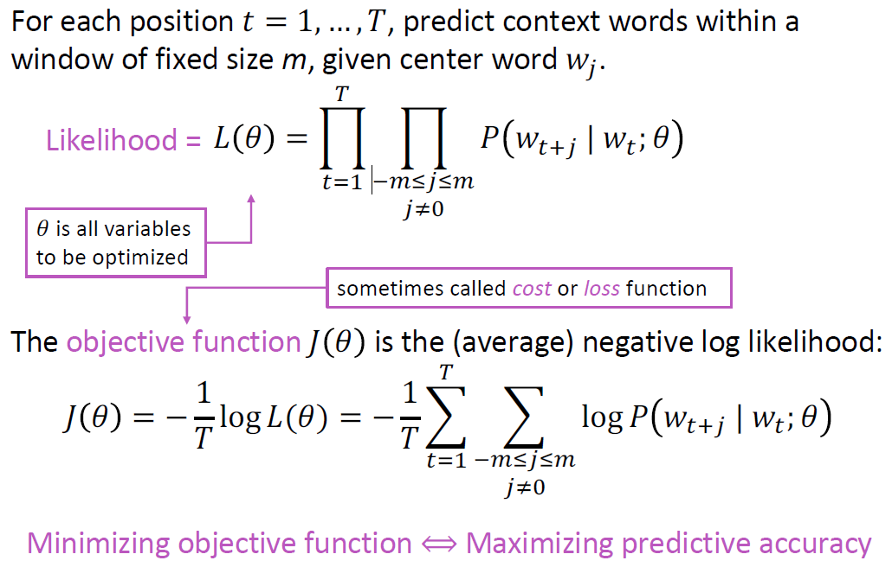
Word2Vec - Objective
Stanford NLP with Deep Learning Course 2019
Chris Manning and Abigail See

Slide 9
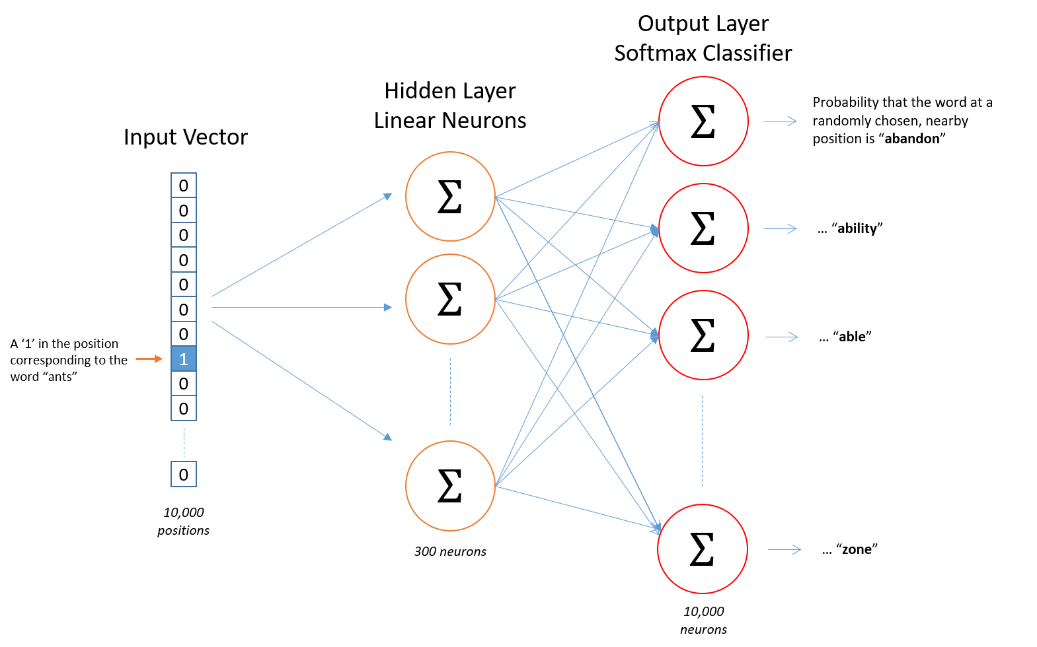
Word2Vec – Network Architecture
Vocabulary size
Word vector dimension
McCormick, C. (2016, April 19). Word2Vec Tutorial - The Skip-Gram Model. Retrieved from http://www.mccormickml.com

Slide 10
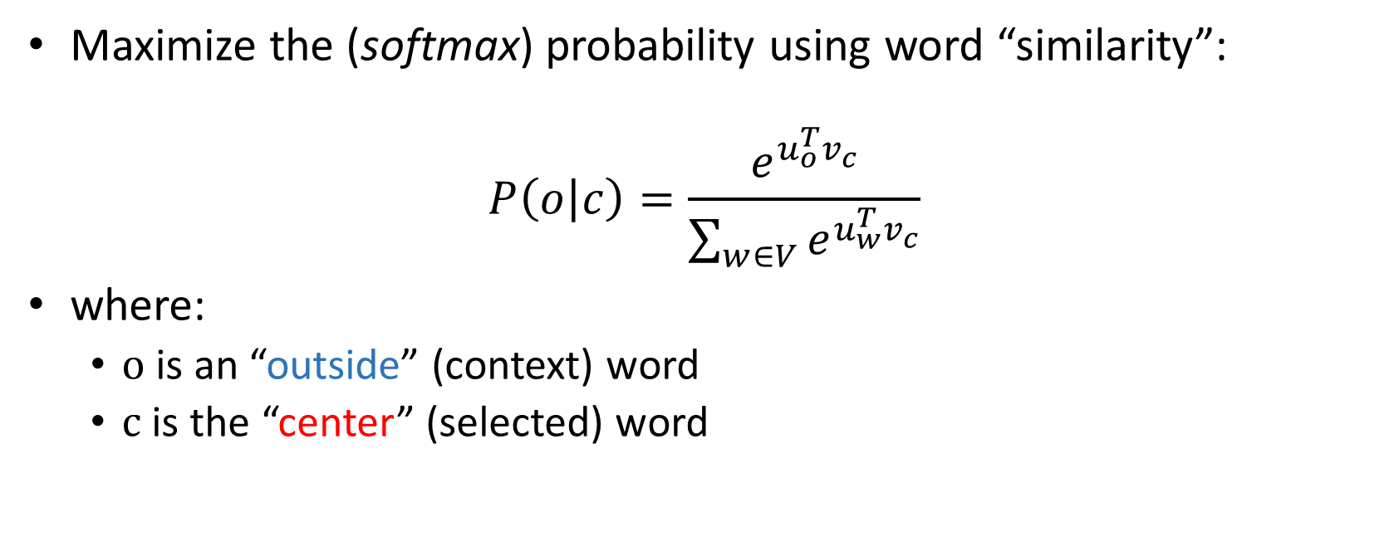
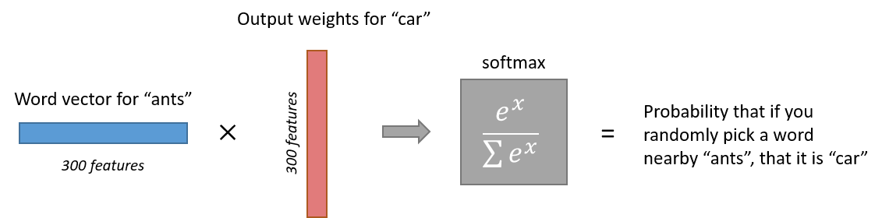
Word2Vec – Skip-gram Model
McCormick, C. (2016, April 19). Word2Vec Tutorial - The Skip-Gram Model. Retrieved from http://www.mccormickml.com

Slide 11
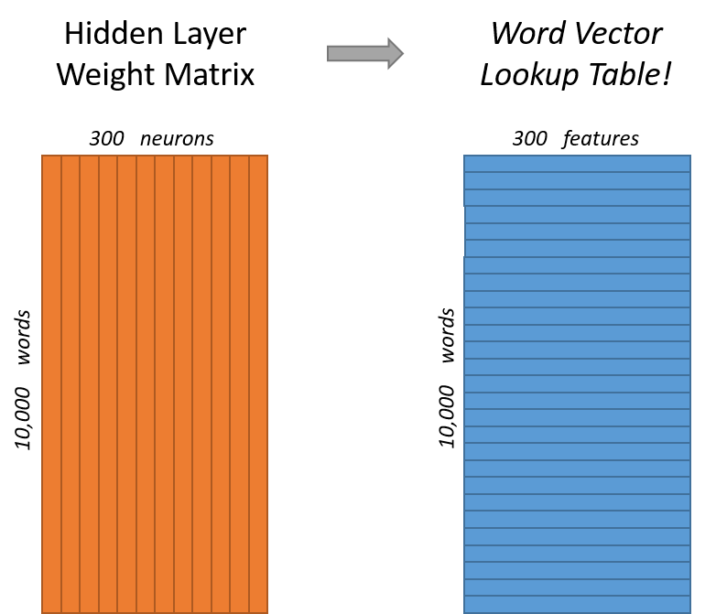
Word2Vec – Result
McCormick, C. (2016, April 19). Word2Vec Tutorial - The Skip-Gram Model. Retrieved from http://www.mccormickml.com

Slide 12


Slide 13
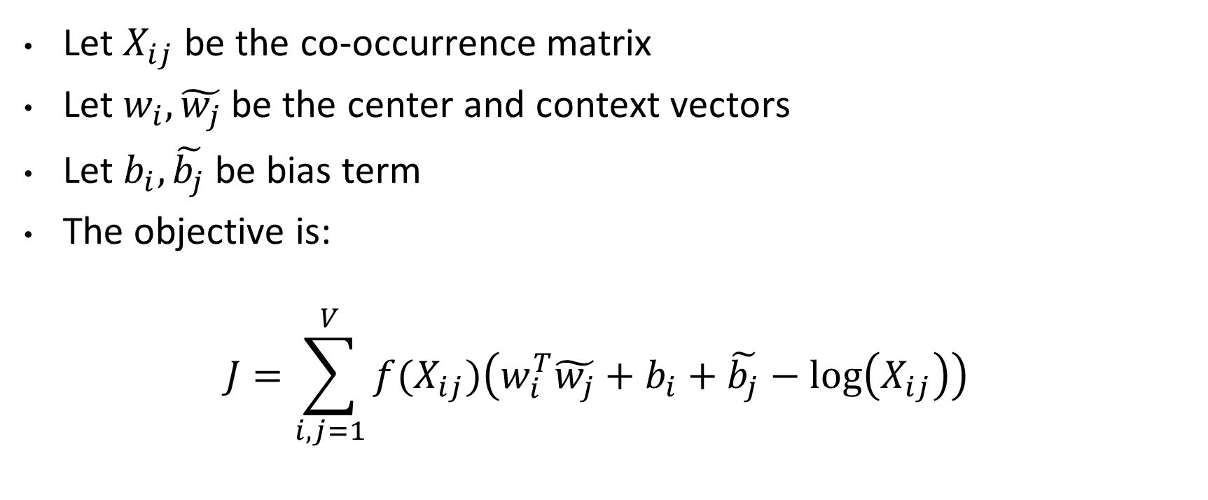
GloVe – Global Vectors [Pennington et al., EMNLP 2014]
Let $X_{ij}$ be the co-occurrence matrix
Let $w_{i}, \tilde{w_{j}}$be the center and context vectors
Let $b_{i}, \tilde{b_{j}}$ be bias term
The objective is:
$$J=\sum_{i,j=1}^{V}{f(X_{ij})\left(w_{i}^{T}\tilde{w_{j}}+b_{i}+\tilde{b_{j}}−\log\left(X_{ij}\right)\right)}$$

Slide 15
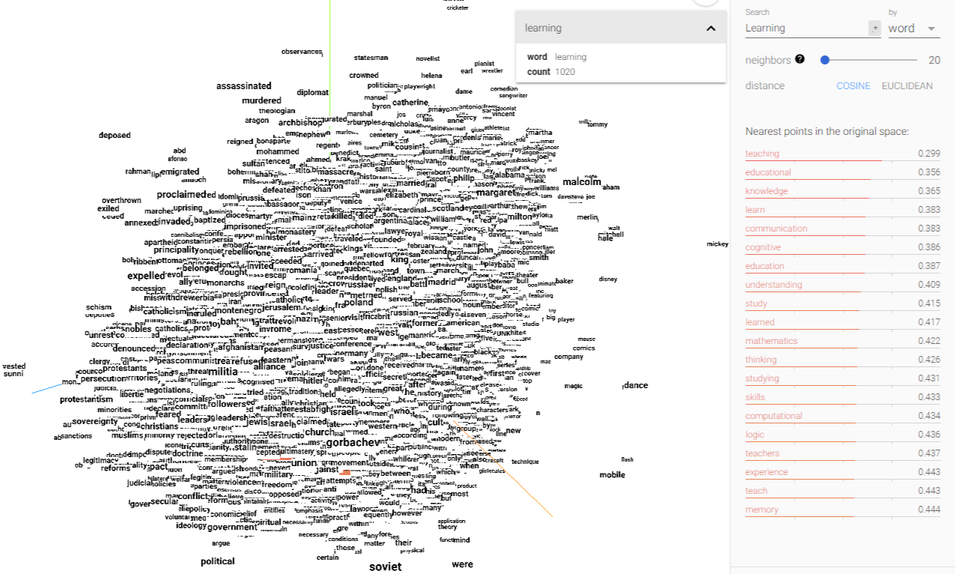
Word Vector Space Models - Discussion
TensorFlow Embedding Projector https://projector.tensorflow.org/

Slide 16
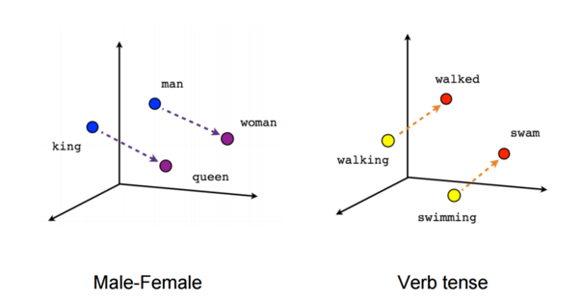

Slide 17

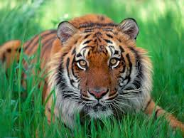
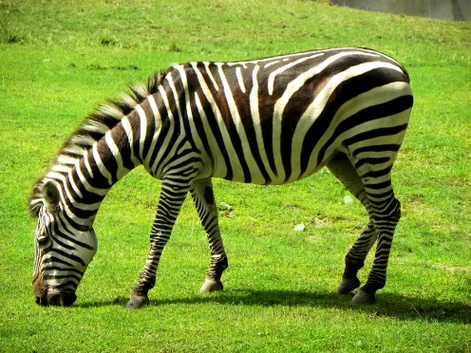
Word Vector Space Models - Discussion
The model is derived from context, but not context sensitive:
One representation (one vector) for the words: play and bank.
Yet they have many different senses, which are context dependent.
bank: border of the lake, financial institute, to pile up…
play: to play a piano, to play with a ball, a play…
Vectors represent words, but how can we represent phrases and sentences?
What about combining different modalities such as visual and textual ? tiger rose zebra
Notes:
Word Embeddings allow us to incorporate textual and visual information in same task

Slide 18
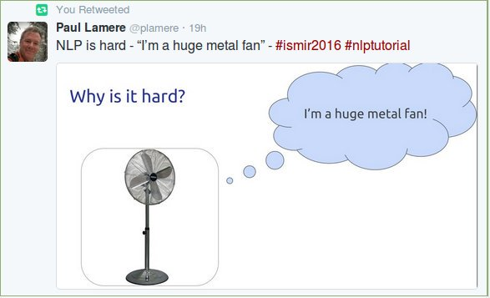
Thank You

